Slide 1


Hi Everyone, Here is My
Project 2 on
VERVE BRIDGE
TOPIC- Real-Time Social Media Sentiment Analysis for Brand Reputation Management
- KHUSHI

Slide 2
TABLE OF CONTENT
INTRODUCTION
OBJECTIVE
METHODOLOGY
TOOLS & TECHNIQUE UTILIZED
DASHBOARD
KEY INSIGHTS
RECOMMADATION
CONCUSION

Slide 3

INTRODUCTION
In today’s digital era, social media has become a key platform for consumers to share their opinions about brands. This project focuses on analyzing real-time social media sentiment to manage brand reputation effectively. By leveraging sentiment analysis and monitoring techniques, the goal is to provide valuable insights that enable brands to respond swiftly to customer feedback. Through this, brands can not only protect but also enhance their reputation. Ultimately, this project helps brands understand public perception and make informed decisions.

Slide 4
OBJECTIVE
The objective of this project is to develop a real-time social media sentiment analysis system to monitor and evaluate public perception of a brand. The goal is to classify sentiments as positive, negative, or neutral, identify key topics of discussion, and provide actionable insights to manage brand reputation effectively. By leveraging advanced data analysis and machine learning techniques, this project aims to enable brands to respond quickly to emerging issues, maintain a positive brand image, and make data-driven decisions for reputation management.

Slide 5
Problem Statement
This project addresses the challenge of managing brand reputation on Twitter, where public sentiment can shift rapidly and impact brand perception. Traditional methods are often too slow to capture real-time feedback effectively. By developing a real-time sentiment analysis system, we aim to classify Twitter sentiments, track key topics, and provide actionable insights. This allows brands to understand and respond to public sentiment promptly, safeguarding their reputation.

Slide 6
METHODOLOGY
Data Collection
Sentiment Analysis
Real-Time Monitoring
Data Preprocessing
Topic Modeling
Insights and Reporting

Slide 7
TOOLS & TECHNIQUE UTILIZED
Python: The primary language for data handling, sentiment analysis, and topic modeling. Python libraries like Pandas are used for data cleaning and manipulation, NLTK and TextBlob for NLP tasks, and Matplotlib and Seaborn for visualization.
TextBlob and VADER: Libraries for sentiment analysis that classify tweet sentiments as positive, negative, or neutral. TextBlob provides sentiment polarity scores, and VADER is specifically tuned for social media data.
Gensim (for Topic Modeling): Utilized to identify and categorize key topics discussed in tweets using Latent Dirichlet Allocation (LDA) for improved trend analysis.
Power BI: For real-time data visualization and monitoring. Power BI displays sentiment distribution, topic trends, and allows for dynamic, interactive dashboards, making insights accessible and actionable.
Jupyter Notebook: Used to document and run Python code in an organized way, allowing for an iterative and flexible approach to data analysis and reporting.

Slide 8
Steps Completed in Python for Real time Twitter sentiment analysis project
Data Collection: Imported a dataset of Twitter data from Kaggle, containing tweets related to the brand and relevant topics.
Data Preprocessing: Cleaned and prepared the data using Pandas by handling missing values, removing duplicates, and normalizing text through the removal of special characters, URLs, mentions, and hashtags.
Sentiment Analysis: Applied sentiment analysis using TextBlob to classify each tweet into positive, negative, or neutral sentiment categories. Calculated polarity and subjectivity scores for each tweet to evaluate the strength and tone of sentiments.
Exploratory Data Analysis (EDA): Created visualizations (bar charts and pie charts) of sentiment distribution to gain insights into overall sentiment trends. Analyzed sentiment per entity to understand which topics or entities had predominantly positive or negative mentions.

Slide 9
Steps Completed in Python for Real time Twitter sentiment analysis project
Topic Modeling: Used Gensim’s LDA to uncover main topics within the tweets, helping to identify the most commonly discussed themes related to the brand.
Entity-Sentiment Analysis: Grouped the data by entities to observe sentiment trends associated with specific topics or individuals, providing a more detailed breakdown of brand perception.
Real-Time Dashboard Preparation: Processed and structured the data for integration with Power BI, enabling the creation of a real-time, interactive dashboard to visualize sentiment trends and key insights.

Slide 10
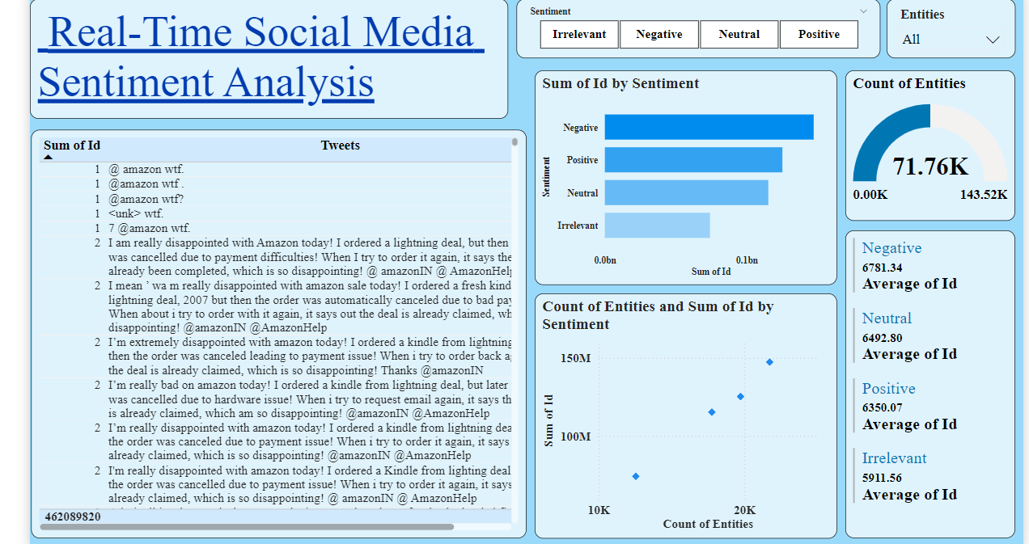
DASHBOARD in POWER BI

Slide 11
KEY INSIGHTS
High Negative Sentiment: A large portion of social media interactions are negative, with common complaints about order cancellations and service issues.
Low Positive Sentiment: Positive mentions are limited, suggesting an opportunity for Amazon to enhance its customer satisfaction efforts.
Strong Engagement: The high number of interactions indicates that customers are actively engaging on social media, particularly regarding service complaints.
Sentiment Distribution: Negative and Neutral sentiments dominate over Positive and Irrelevant, showing that issues significantly impact brand perception.
Focus Areas for Improvement: The concentration of negative feedback in specific areas suggests potential focal points for customer service and operational improvements.

Slide 12
RECOMMANDATION
To enhance brand reputation, it is recommended to prioritize monitoring and responding to negative sentiments across social media platforms in real-time. Regularly engage with positive feedback by acknowledging satisfied customers and utilizing their testimonials for promotional content. Additionally, the use of targeted campaigns based on sentiment analysis can drive positive brand interactions, while consistent tracking of sentiment trends can ensure timely intervention when necessary.

Slide 13
CONCLUSION
In conclusion, real-time sentiment analysis offers valuable insights into public perception and brand reputation. By analyzing social media sentiments and identifying key topics, businesses can make data-driven decisions to improve customer satisfaction. This approach helps in managing brand perception proactively and enhancing overall engagement with customers. Implementing a sentiment analysis system can significantly contribute to building stronger brand loyalty and improving customer relationships.

Slide 14
THANK
YOU

